Slide 1


Day 02
contact@anubhavtrainings.com
ABAP RESTFUL APPLICATION PROGRAMMING

Slide 2

Agenda – Day 02
Introduction to CDS Views Basics
Introduction to CDS entities
Describing AMDP with Use Case
Table function
Service Definition & Service Binding
Introduction to SAP Business Application Studio
Common Challenges in ABAP Development
Evolution of ABAP Programming Model
What is RAP (Restful Application Programming)
Flow of Restful Application Programming
Types of Scenarios
Managed Scenario
Unmanaged Scenario
Explanation of Flight Data Model
Defining Unmanaged Scenario
Flow of Development (Unmanaged Scenario)
Defining CDS Views
Notes:
Creating OData Service ( Business Service)
Introduction to Fiori Elements
Free style v/s Fiori Elements App
Developer persona – Fiori Elements
List Report Object Page App
Developing Read-Only List Reporting Apps
UI Annotation
Adding Search Capabilities
Adding Metadata Extension

Slide 3

Code To Data Paradigm
ABAP System
CDS Views
NW 7.4 SP6
Any DB
AMDP/Table Function
7.4SP6, 7.5
HANA DB
HANA Views
SQL Script procedure and function
www.anubhavtrainings.com

Slide 4
Why we need views in ANY SOFTWARE
Hide complexity – Imagine we have a ERP system, usually data in ERP is spread across MULTIPLE tables. Reading the data with Query becomes complex and error prone. We code VIEWS with all selections, conditions, and associations (joins). It provides data from functional point of view.
Security – We do not want to give direct access to DB tables, because tables are prone to attacks and security breach. Hence we create views, by masking (hiding), projections of the relevant data for the business use case. We additionally add ROW level security.
Modularization – We can develop complex functionalities by small size modules. Which calls and orchestrates between each other. It brings reusability and reduces redundancies.
In context of SAP CDS, we have annotations, framework consumptions, ease of development, support for tools, support for multiple use case, industry standard, inherent documentation.
Private views
Interface views
Consumption views
Developers only access to be used within other views, direct consumption should be prohibited.
Basic
Composite
Used for final consumption built on top of interface views.
They are reusable views can be consumed for any purpose, as they build a bridge between tables. Basic views are pure master, transaction data but composite views are combination of master and transaction data.
www.anubhavtrainings.com

Slide 5
Use Case
We want to develop a set of views which usages our custom data model to expose sales data for each customer and product.
Consumption 1
Total sales per customer
Composite
Total sales per product
https://help.sap.com/docs/BTP/5371047f1273405bb46725a417f95433/2d3a05e516374108b5881840267a13b2.html
Composite
Interface Sales
Interface Customers
Interface Products
I_Country
BusinessPartner
Sales Order Header
Sales Order Item
product
www.anubhavtrainings.com
I_Currency

Slide 6
Creating CDS View
ZATS_00_C_SOFTSALES
ZATS_00_I_BP
ZATS_00__I_SALES
ZATS_00_SO_I
0..1
ZATS_00_BP
0..1
ZATS_00_I_SALESHDR
ZATS_00_P_PROD
0..1
ZATS_00_SO
ZATS_00_Product
Exercise
Create CDS View According to VDM

Slide 7
CDS Entity
CDS entity is EXACTLY like CDS Views but with
optimized performance,
A single object for all purpose basically no more 3 names
No need to create DDIC view
The HANA view name will be same as CDS entity Name
Exceptions
CDS entities does not support BOPF integration
www.anubhavtrainings.com

Slide 8
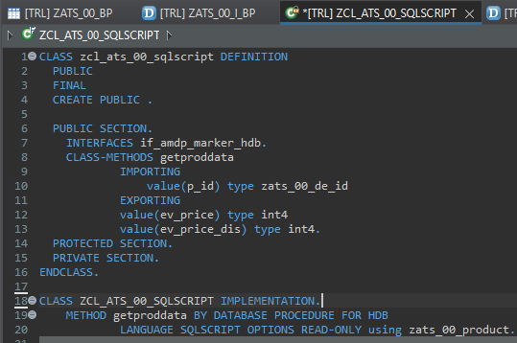
Describing AMDP
ABAP Managed Database Procedures (AMDP) are the preferred way for developing SAP HANA DB procedures on the ABAP platform. Since ABAP Managed Database Procedures are implemented as methods of a global ABAP class, the editing environment for AMDP is the ABAP class editor.
Requirement 1: Pass the product id, system should calculate the discounted price and return
actual and discounted price.
There are 2 types of SQL Script contains:-
Procedure - can have multiple return values
Function - always have one return value
Exercise
Create AMDP

Slide 9
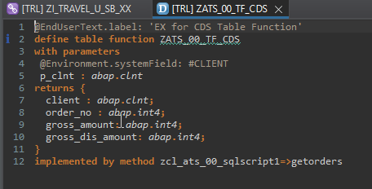
Creating Table Function
A CDS table function is defined using the ABAP CDS statement DEFINE TABLE FUNCTION and can be used as the data source in Open SQL read statements.
Each CDS table function includes the following components:
The actual CDS entity of the table function that is generated in the ABAP Dictionary
The CDS table function implementation (ABAP class library)
Requirement 2: return all the sales order no, amount (actual), discounted amount of sales orders]
Exercise
Create Table Function

Slide 10
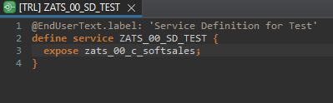
Service Definition
The service definition is a projection of the models and related behavior that you want to expose. In a service definition, you define the OData service to determine which CDS entities are part of the service. This service is then bound to a protocol and to either a UI technology or an A2X service by a service binding artifact. A service definition can be integrated in various protocols without any reimplementation.
Exercise
Service Definition

Slide 11
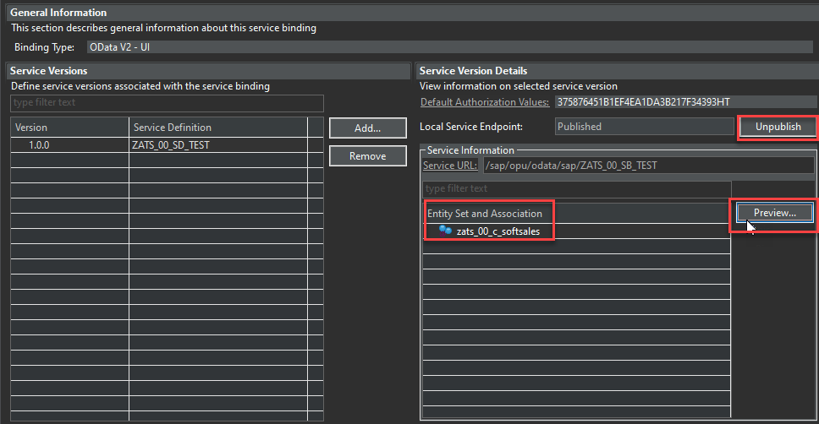
Service Binding
A service binding implements the protocol that is used for the OData service. It uses a service definition that projects the data models and their related behaviors to the service.

Slide 12
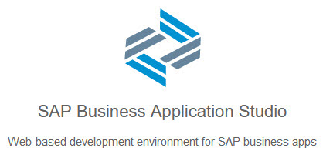
BAS Introduction
SAP Business Application Studio is a new SAP Business Technology Platform (BTP) service that offers a modern development environment tailored for efficient development of business applications for the SAP Intelligent Enterprise.
SAP Business Application Studio provides a tailor-made development environment for various development scenarios, such as SAP Fiori, SAP S/4HANA extension, and Workflow. With each of these scenarios, you can create different types of applications.
These tools cover the end-to-end development cycle:
Clone an existing project with a Git client or create new project using templates.
Use editors for SAP-specific technologies.
Easily test your application on your dev space while consuming services from remote sources.
Build and deploy the application as a multitarget application (MTA).

Slide 13
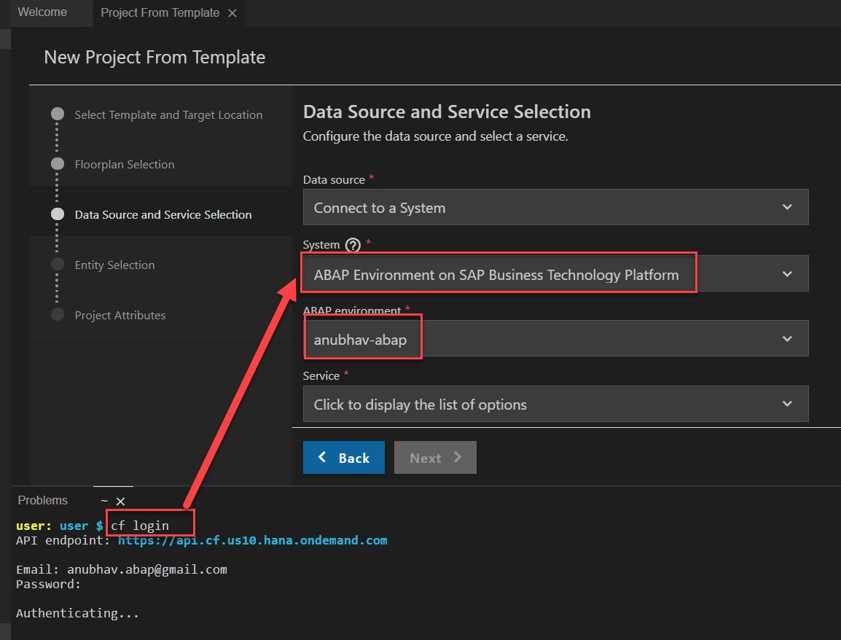
Creating Fiori App on BAS
Creating Fiori App on BAS Using Service on Top of CDS Model.
First Login Cloud Foundry ( cf login ).
Select System ABAP Environment on SAP BTP.

Slide 14
AMDP CDS Table Function
AMDP when called, creates a procedure in HANA
We can have multiple input and output parameters
We can use AMDP for write operations
We cannot join an AMDP with CDS views or entities
TF when called, it creates a Table Function (UDF) in HANA
We can have multiple input but the output is ONLY one
Always read only
Can be used as join/association with another CDS views

Slide 15




Challenges in ABAP development
UI
Common needs
Create application logic
Insert, update, delete, validate, select data
Perform validations
Check customizing
Handle locks
Create A/c documents
Manage Documents
Application Code
I, U, D, S, V
Search Documents
Validate before save
Alex, ABAP Developer,
SAP FICO
UI
Challenges
Thinks differently
Adapt application code
High maintenance
No standardization
Different coding practices
Lack of standard
Create Sales Orders
Manage Sales Orders
Application Code
I, U, D, S, V
Search/Filter Sales Order
Compute Sales total
Stella, ABAP Developer,
SAP SD
Trainer: Anubhav Oberoy

Slide 16
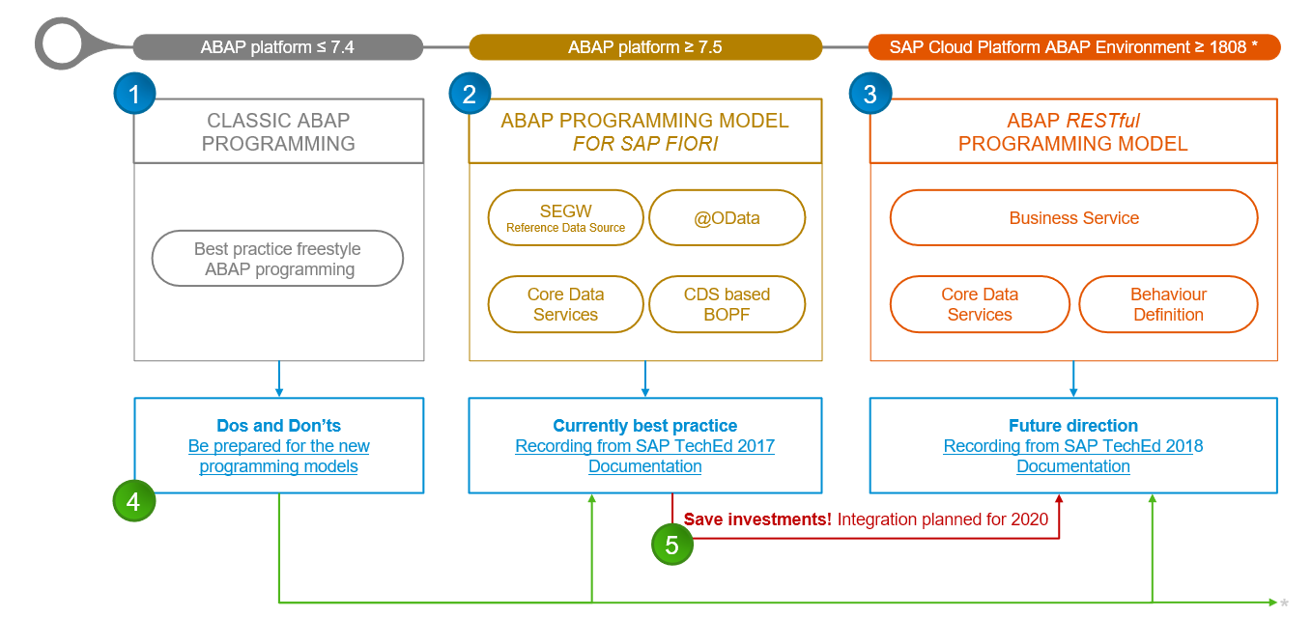
Evolution of ABAP Programming Model

Slide 17
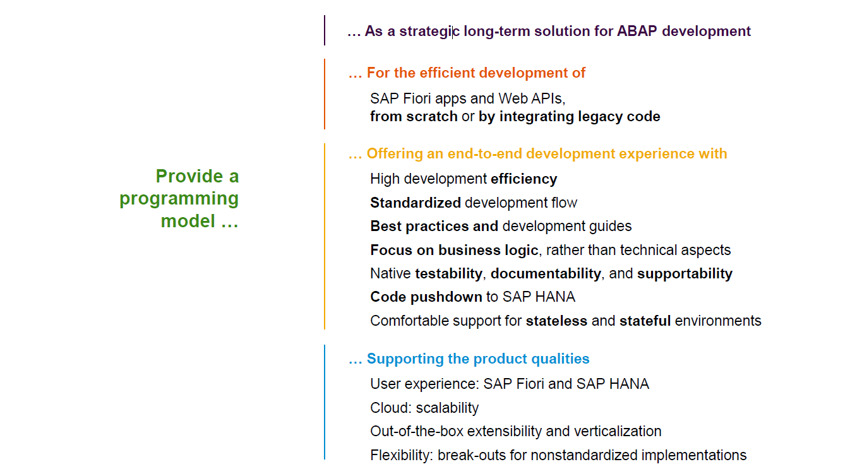
Restful ABAP Programming

Slide 18
Restful ABAP Programming
The ABAP RESTful programming model defines the architecture for efficient end-to-end development of intrinsically SAP HANA-optimized OData services (such as Fiori apps) in SAP Business Technology Platform ABAP Environment. It supports the development of all types of Fiori applications as well as A2X services. It is based on technologies and frameworks such as Core Data Services (CDS) for defining semantically rich data models and a service model infrastructure for creating OData services with bindings to an OData protocol and ABAP-based application services for custom logic and SAPUI5-based user interfaces .
The whole architecture is based on
CDS views – will helps you to create semantically rich data model.
Business Object here is a node inside a tree data structure which is achieved by using root keyword at CDS view level, this is needed only if we want to add transactional capability.
Finally create a service using service definition and service binding .
The binding will confirm the Purpose of service – API or Fiori.
UI layer with the Fiori app using elements.

Slide 19

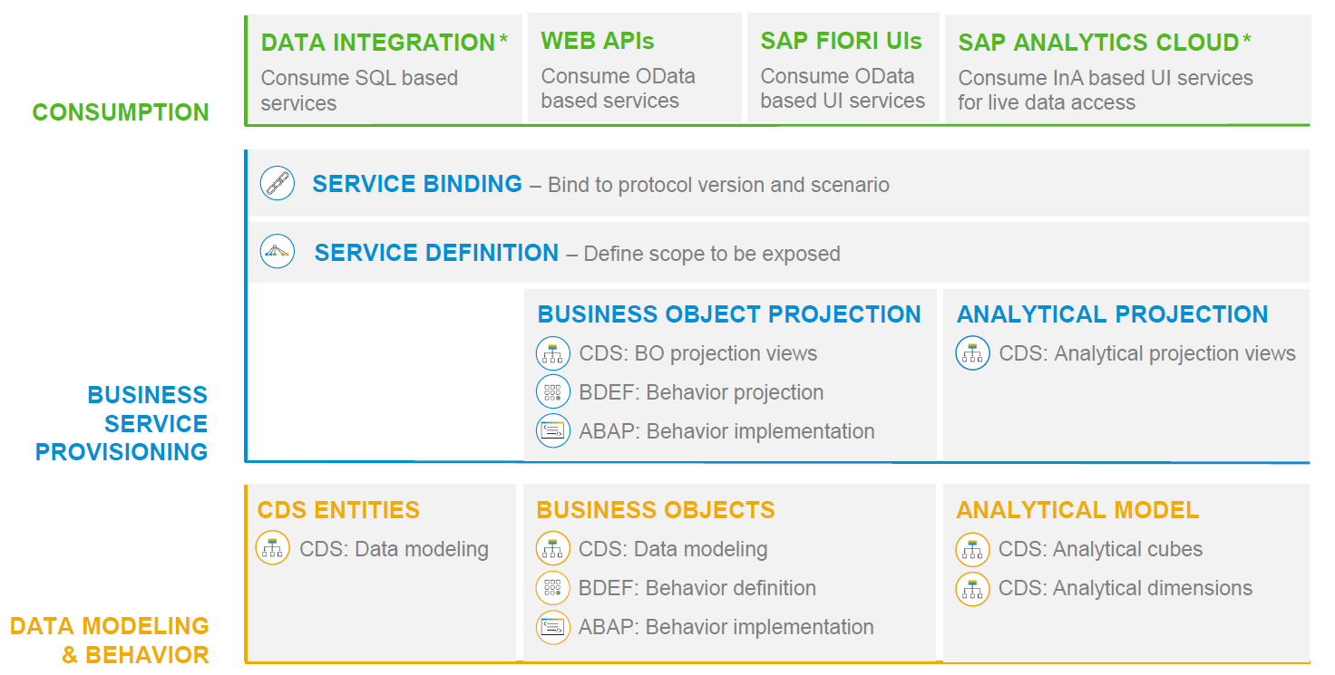
RAP – The Big picture

Slide 20
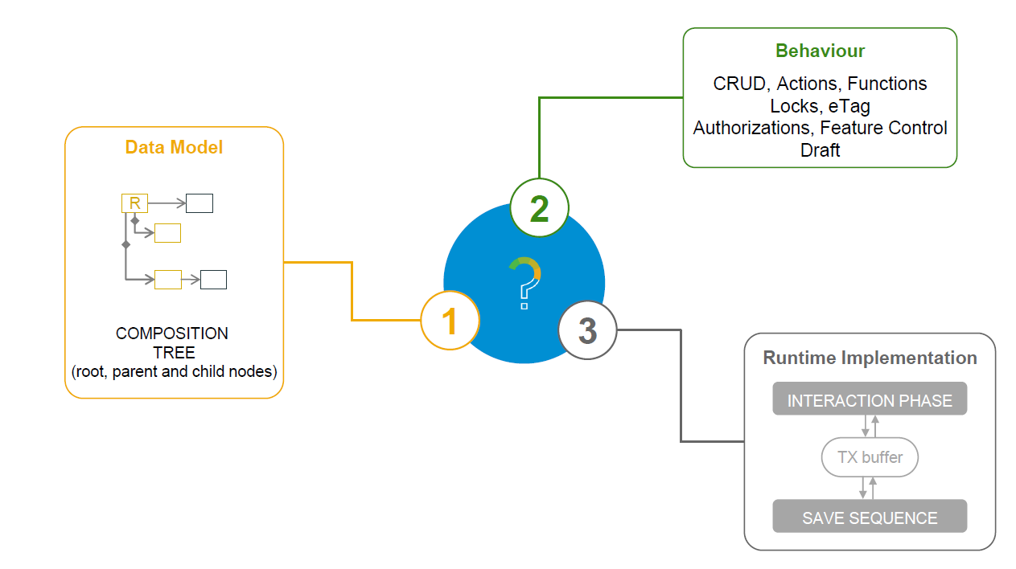
What is a Business Object

Slide 21
Types of Implementation (Scenario)
Brownfield Implementation
Is used when we want to create a transactional application which can insert, update, delete data from the system by writing your own logic
You already have Business logic with you and you want to use that business logic to perform transactional capability
You are own your own to manage your implementation.
02. Managed Scenario
Greenfield Implementation
Is used when we want to create a transactional application which can insert, update, delete data from the system by using the framework provided implementation
You do not have Business logic with you and you want system to create business logic for you automatically.
01. Un-Managed Scenario

Slide 22
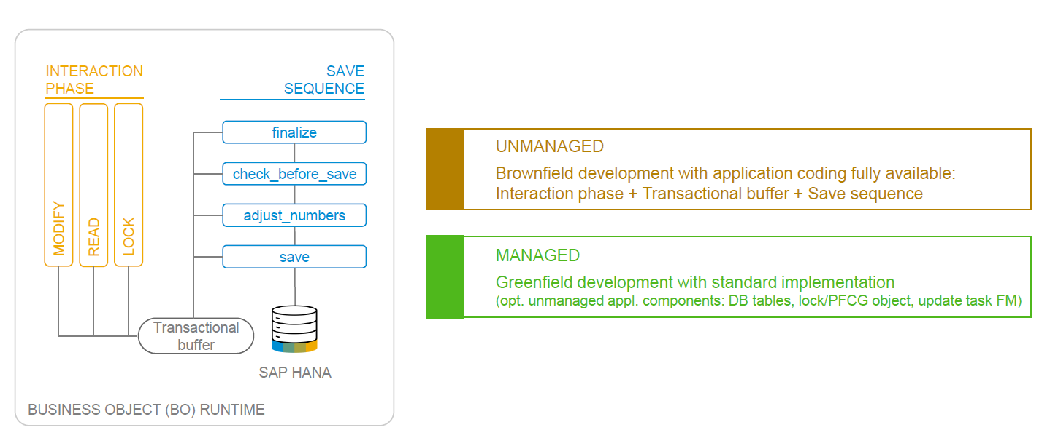
BO runtime implementation types

Slide 23
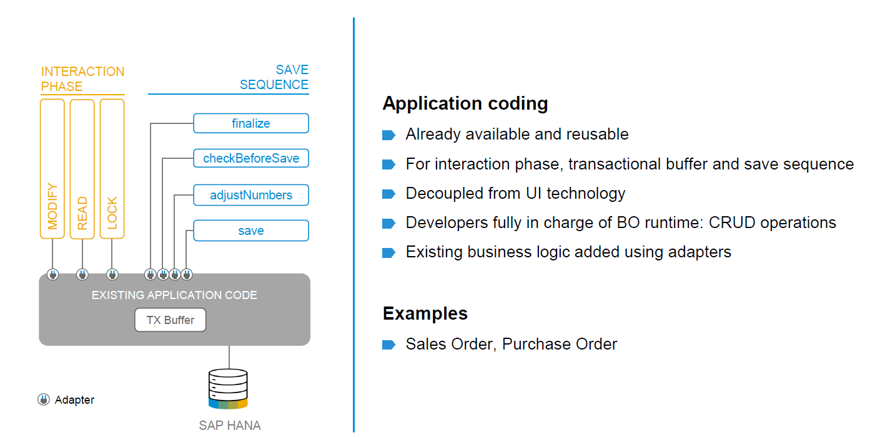
BO runtime implementation types

Slide 24

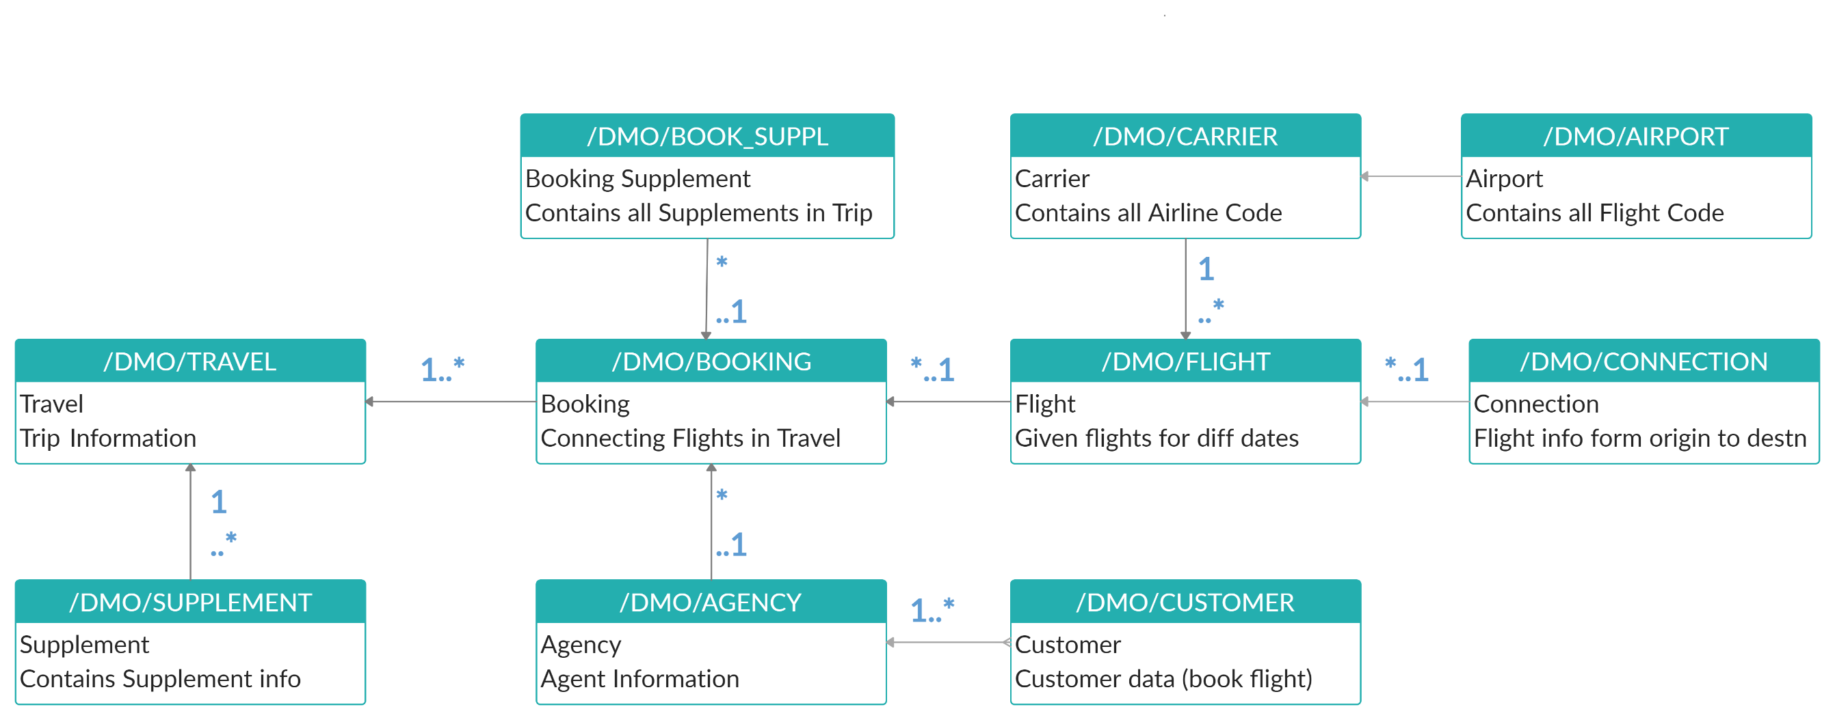
Explanation of Flight Data Model
If Data is not found in these Table’s please execute Data Generator Class “/dmo/cl_flight_data_generator”

Slide 25
Flow of Development (Unmanaged Scenario)
Fiori UI
Service Binding for UI
Service Definition
Travel – Using /demo/travel
Projection view- what we want to show to UI
1
N
I_Currency
1
N
N
Agency
Customers
I_Country

Slide 26
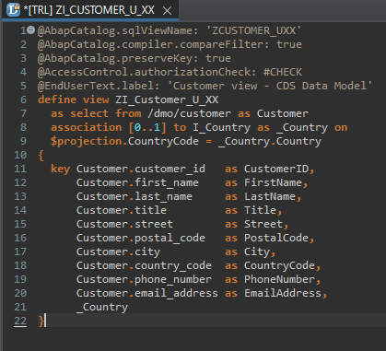
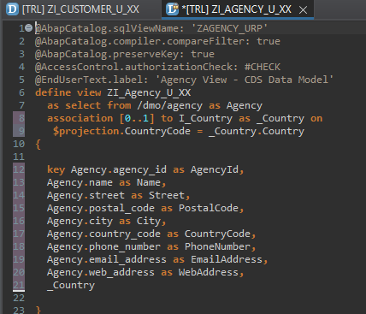
Defining Data Models
Defining Data Models
Create Customer CDS View “ZI_Customer_U_XX”
Create Agency CDS View “ZI_Agency_U_XX”

Slide 27
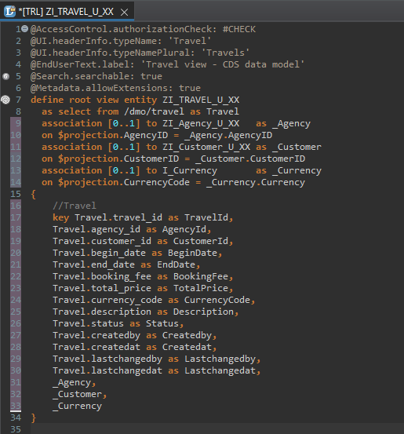
Root CDS Entity
Root CDS Entity
On top of Customer and Agency CDS View we Create Root CDS View Entity called “ZI_TRAVEL_U_XX”.
With Annotations like Metadata ,Search ,
Semantic Annotation etc.
Association to Agency ,Customer , Currency.

Slide 28
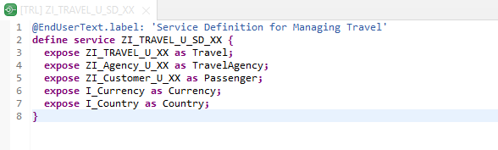
Create OData Service ( Business Service )
Create OData Service ( Business Service )
A business service definition (short form: service definition) describes which CDS entities of a data model are to be exposed so that a specific business service, for example, Sales Order handling, can be enabled. It is an ABAP Repository object that describes the consumer-specific but protocol-agnostic perspective on a data model. “ZI_TRAVEL_U_SD_XX”
CDS Entity
Service Definition
Service Binding

Slide 29
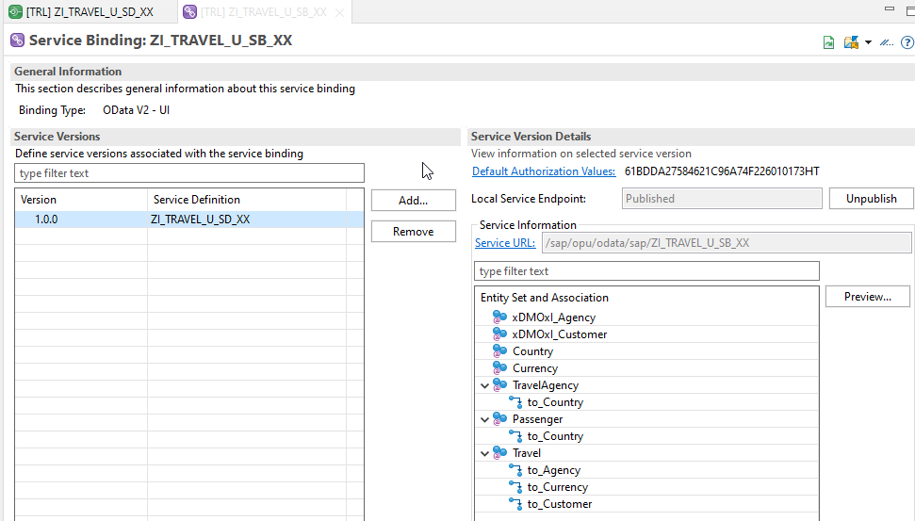
Service Binding ( Business Service )
Service Binding ( Business Service )
The business service binding (short form: service binding) is an ABAP Repository object used to bind a service definition to a client-server communication protocol such as OData. Like any other repository object, the service binding uses the proven infrastructure of the ABAP Workbench, including the transport functionality

Slide 30
Introduction to SAP Fiori Elements
SAP Fiori elements provides standard floorplans and uses metadata to streamline and accelerate developing SAPUI5 applications.
SAP Fiori elements
▪ Delivers enterprise-ready SAPUI5 apps based on
stable, optimized, out-of-the-box UI code
▪ Boosts developer efficiency by scaling development
and maintenance in a cost-efficient way
▪ Provides a centrally managed, consistent UX
complying with the latest SAP Fiori design
▪ Ensures upgrade stability and forward compatibility
▪ Allows extensibility of standard floorplans with custom
controls and logic
www.anubhavtrainings.com

Slide 31
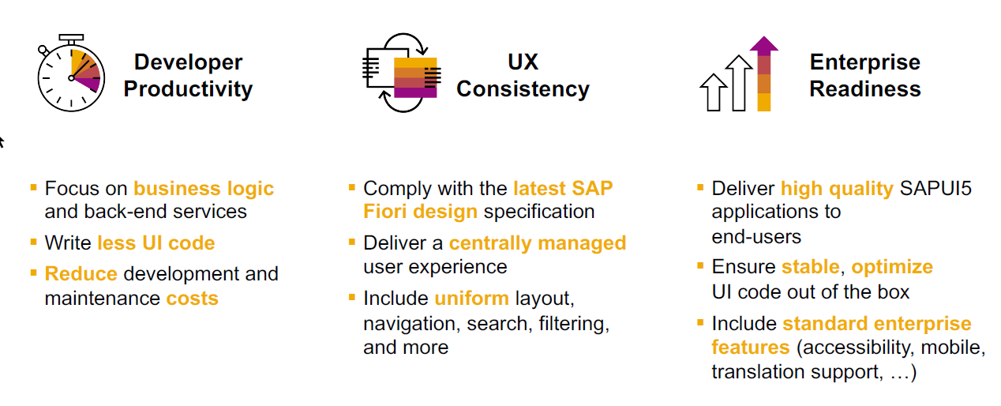
SAP Fiori elements boosts SAP Fiori development efficiency
www.anubhavtrainings.com

Slide 32

SAP Fiori elements prioritizes efficiency over flexibility
www.anubhavtrainings.com

Slide 33


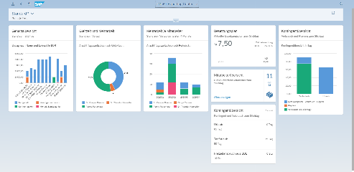





Developer Persona – Fiori Elements
Anubhav
Happy User
Rob
S/4HANA Technical consultant
ABAP Developer
Roxana
UX Designer | Fiori Developer
ABAP Dev. Tools
On
Eclipse
VS Code
BAS
OData Service
Fiori Elements Project
Annotations.xml
CDS Views
MDE
@
www.anubhavtrainings.com

Slide 34
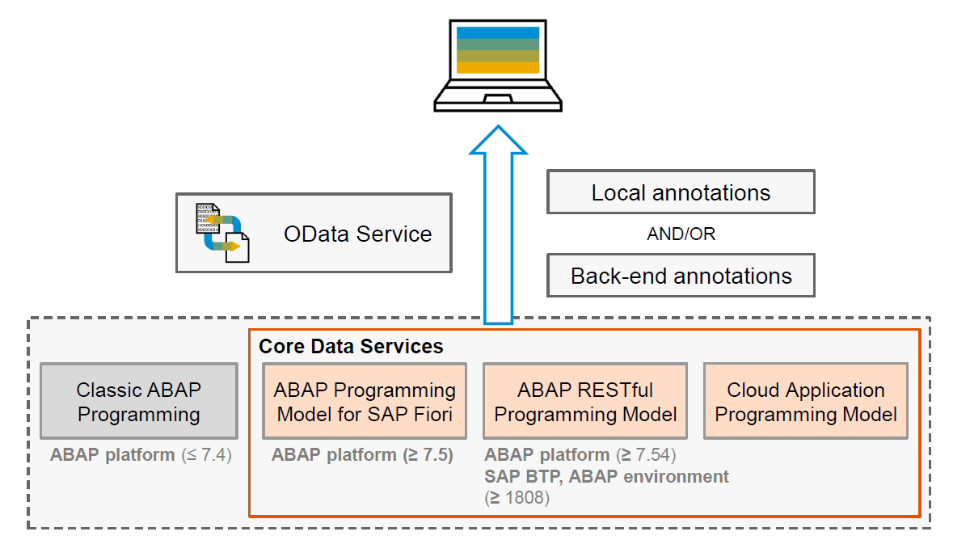
Big Picture – Architecture
www.anubhavtrainings.com

Slide 35
Metadata extension
When we develop CDS views, we can put many annotations inside CDS. But when we looking forward to develop a UI application, we want @UI annotations. By putting these UI annotations directly inside CDS, we are talking risk.

Slide 36
Fiori Elements - List Report Application
The list report offers powerful features for finding and acting on relevant data sets. It is often used as an entry point for navigating to the item details, which are usually shown on an object page.
List Report
Object Page
www.anubhavtrainings.com

Slide 37
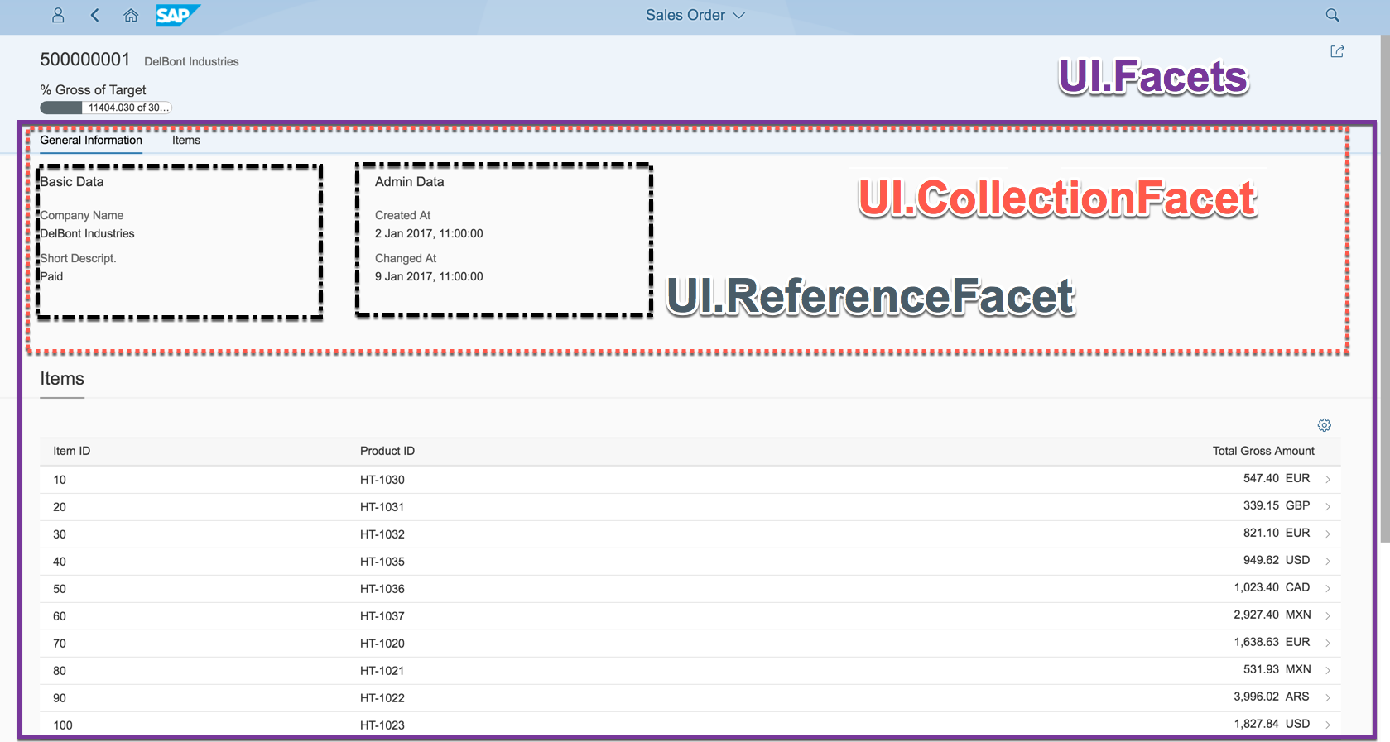
Object Page
www.anubhavtrainings.com

Slide 38
Developing Read only List Report
UI Annotations
@UI.selectionField – Bring a filter field on smart filter bar
@UI.lineItem – enable us to put a column inside the smart table, position, label
@UI.identification – used create fields in Object page
@Semantics.amount.currencyCode – mark the unit of amount field
@UI.headerInfo.typeName – Label for displaying single record
@UI.headerInfo.typeNamePlural – Table Label
@UI.facet: [{purpose : #STANDARD – This will create a section inside the object page
type: #IDENTIFICTION_REFERENCE – What type of data you want to display}]
Metadata Extension
MDE file for Travel
Documentation
Documentation Link for ABAP RAP

Slide 39
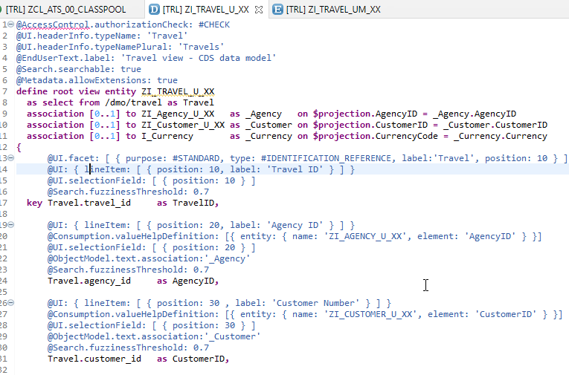
CDS Views with Annotations
Exercise
ZI_TRAVEL_U_XX ( Travel )

Slide 40

End of Day 02
Trainer: Anubhav Oberoy

Slide 41

Trainer: Anubhav Oberoy

Slide 42
THANK YOU
If you cannot do
great things, do small things in a great way.
Anubhav Oberoy
https://www.anubhavtrainings.com

Slide 43


We’re committed to empower you to be
Most Desirable Resource
through powerful training solutions.
We build the workforce of the future.
250+
Corporate Clients
30,000+
Learners Trained
25000+
Learners Placed
FREE WEBINARS
Sign up for free webinars with industry experts every fortnight!
Enroll Now!
Contact us today!
https://anubhavtrainings.com/

Slide 44




More from AnubhavTrainings.com

